Slide 1

Year 10 Work Experience
Monday 12th July to Wednesday 21st July 2027

Slide 2

Why take part in work experience?
To gain knowledge and understanding of how industry operates.
To understand how important the school curriculum is in the world of work.
To have the opportunity to develop vital employability skills such as self confidence, communication and time keeping.
To experience possible career paths and find out about the further training you may need to have a role in your chosen sector.
To find out what qualifications you will need to enter a field of work

Slide 3


Slide 4
How does my child find a work placement?
The expectation is that students find their own work placement.
Your child will need to make contact with a placement via email, written letter, in person or by telephone.
They need to obtain the following information
Company name
Name of the main contact at the company
The email address of the main contact at the company
Company address
Company telephone number

Slide 5
They don’t know what they want to do.
Work experience can help them discover what they don’t like as well as what they do like.

Slide 6
Next steps.
Sign into Unifrog- all students have an account set up.
Username- school email address
Complete the careers quiz
Encourage them to talk to friends and family- can they offer them a placement?
Contact businesses that they would like to work for.

Slide 7
As soon as they find a placement
Log the details on Unifrog making sure that key details such as the employers email address are entered correctly.

Slide 8


Slide 9
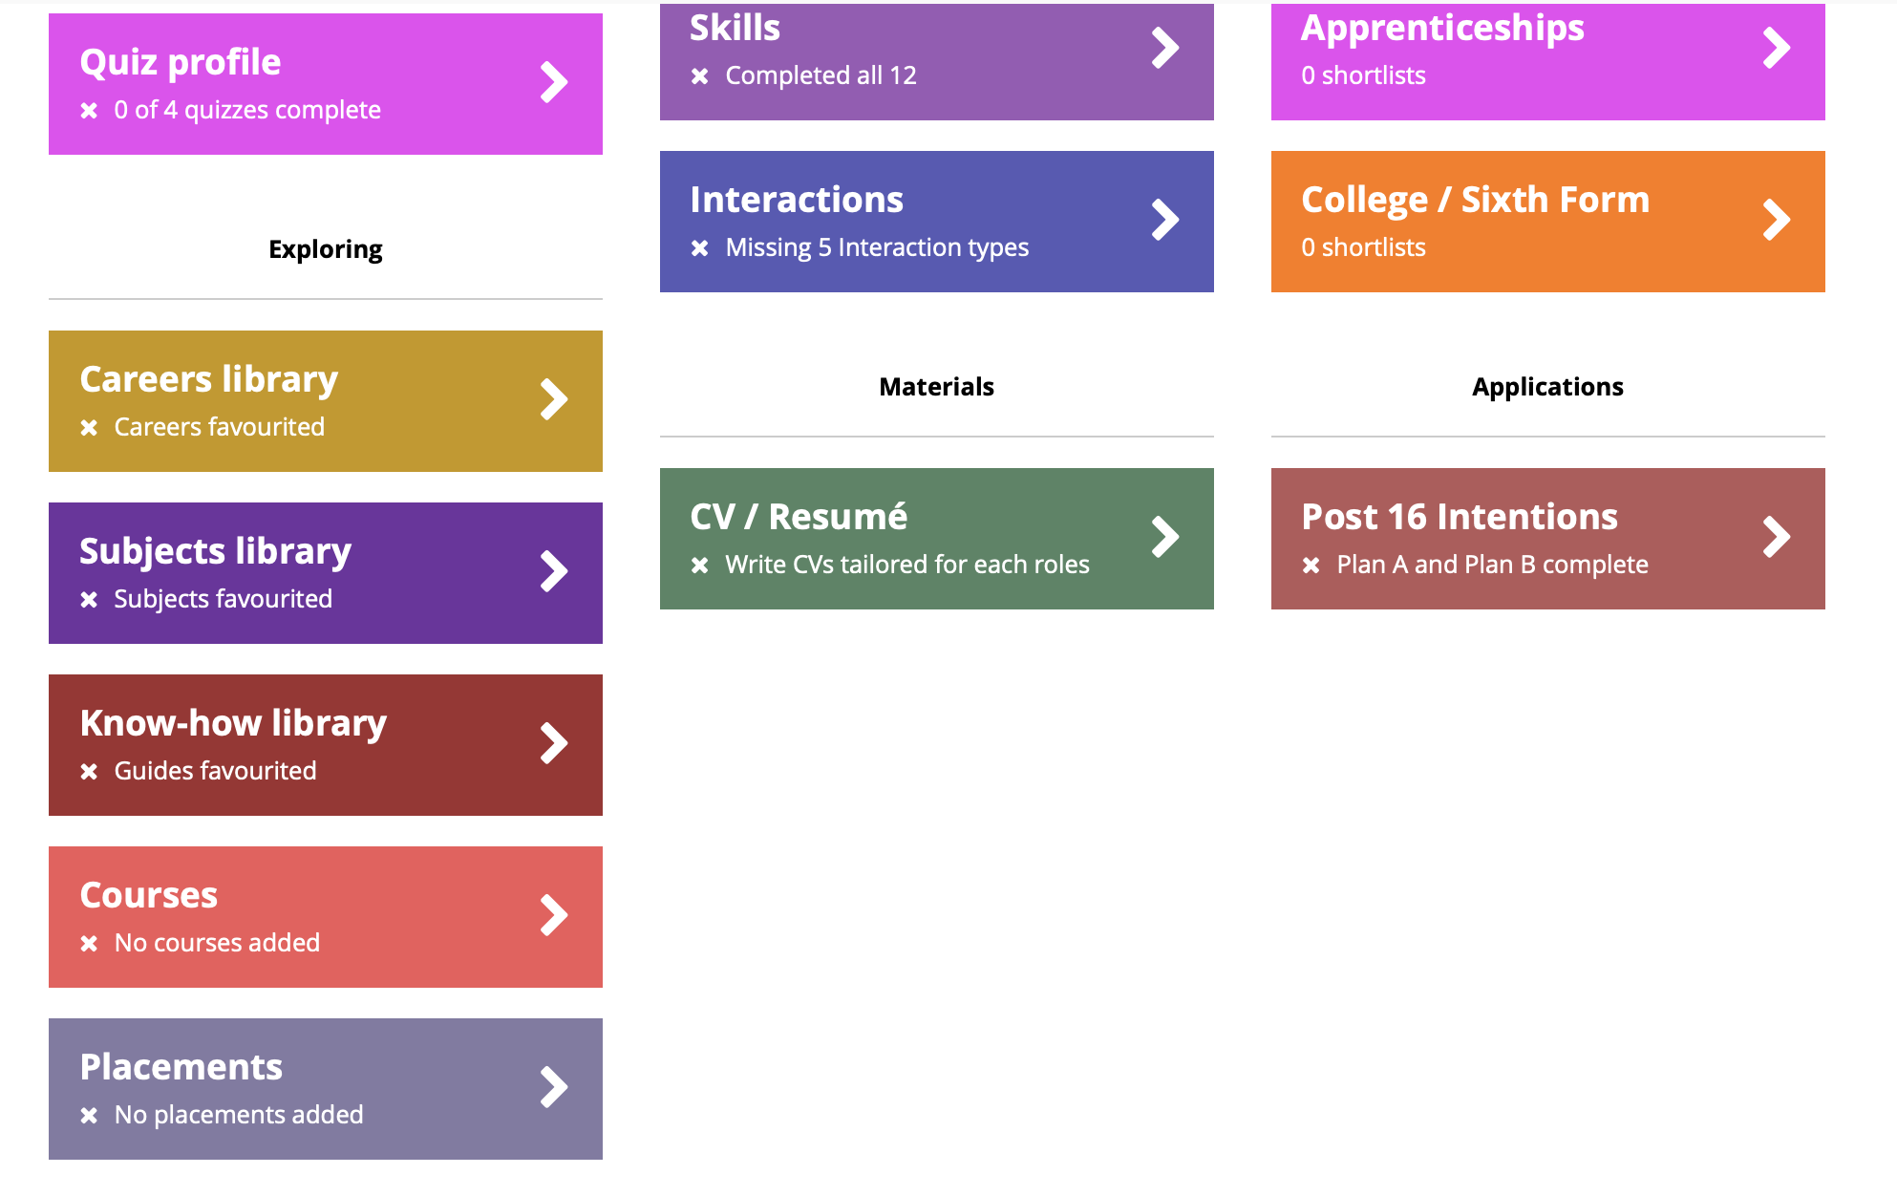

Slide 10
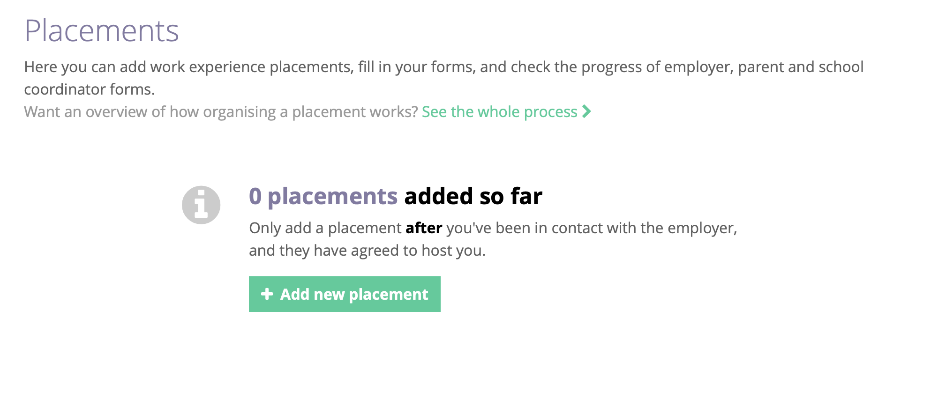

Slide 11
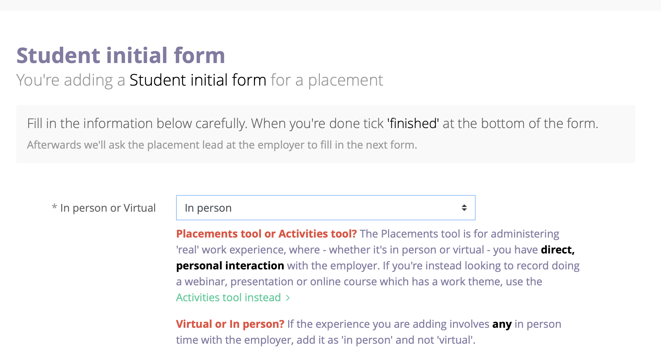

Slide 12
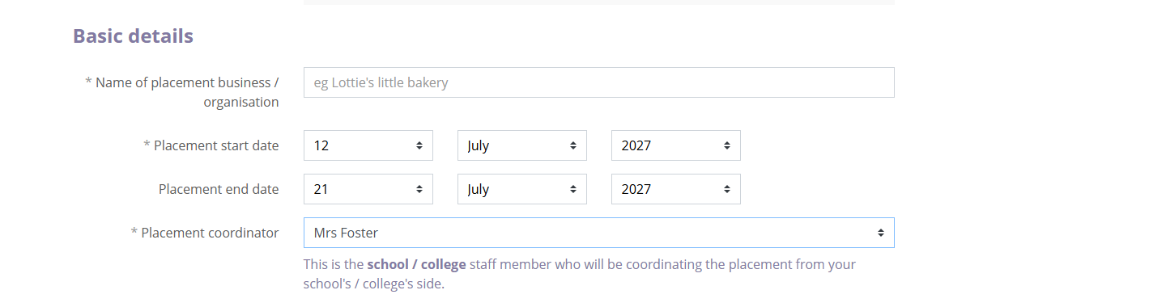

Slide 13
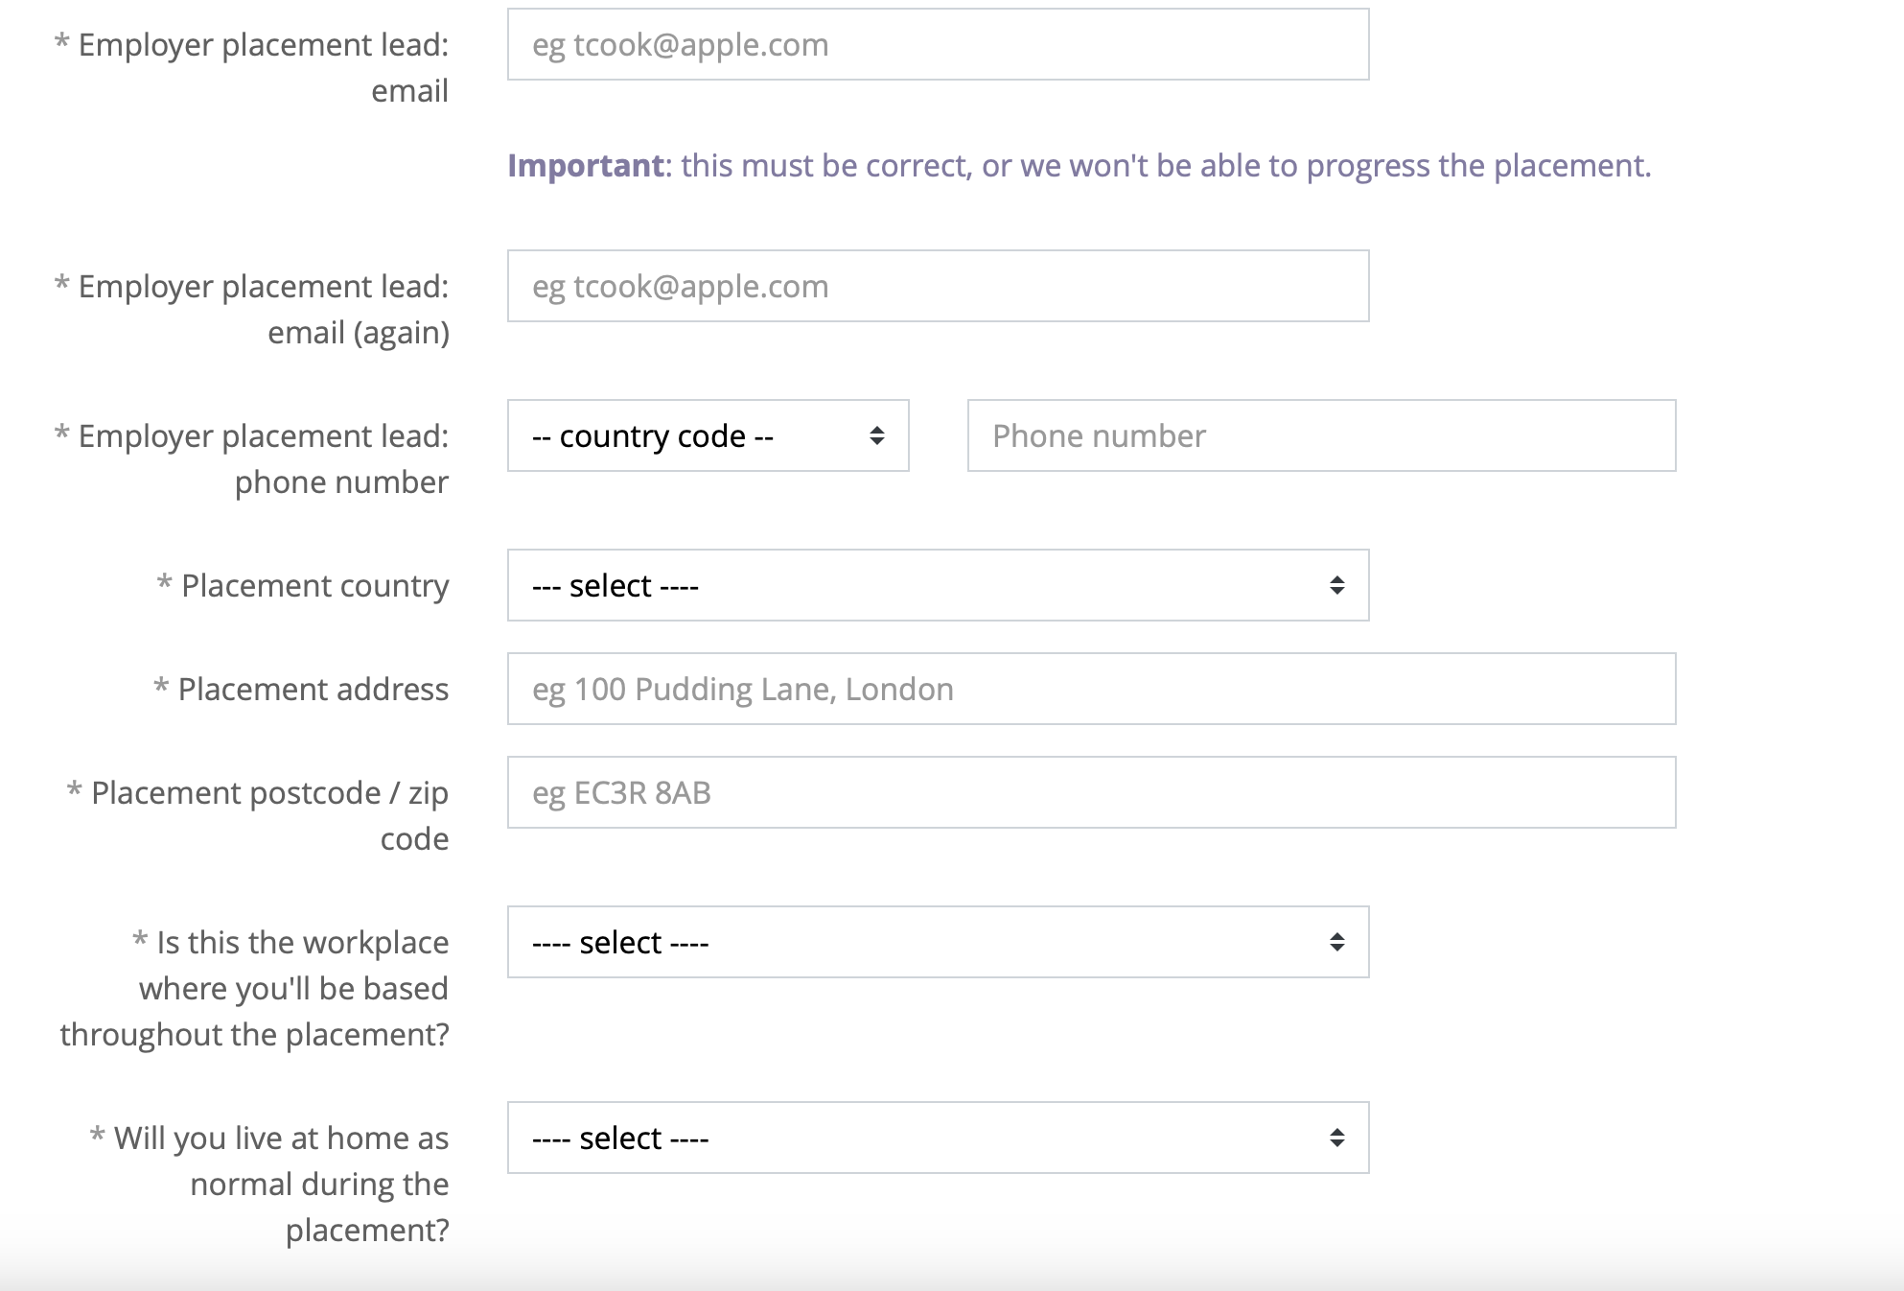

Slide 14
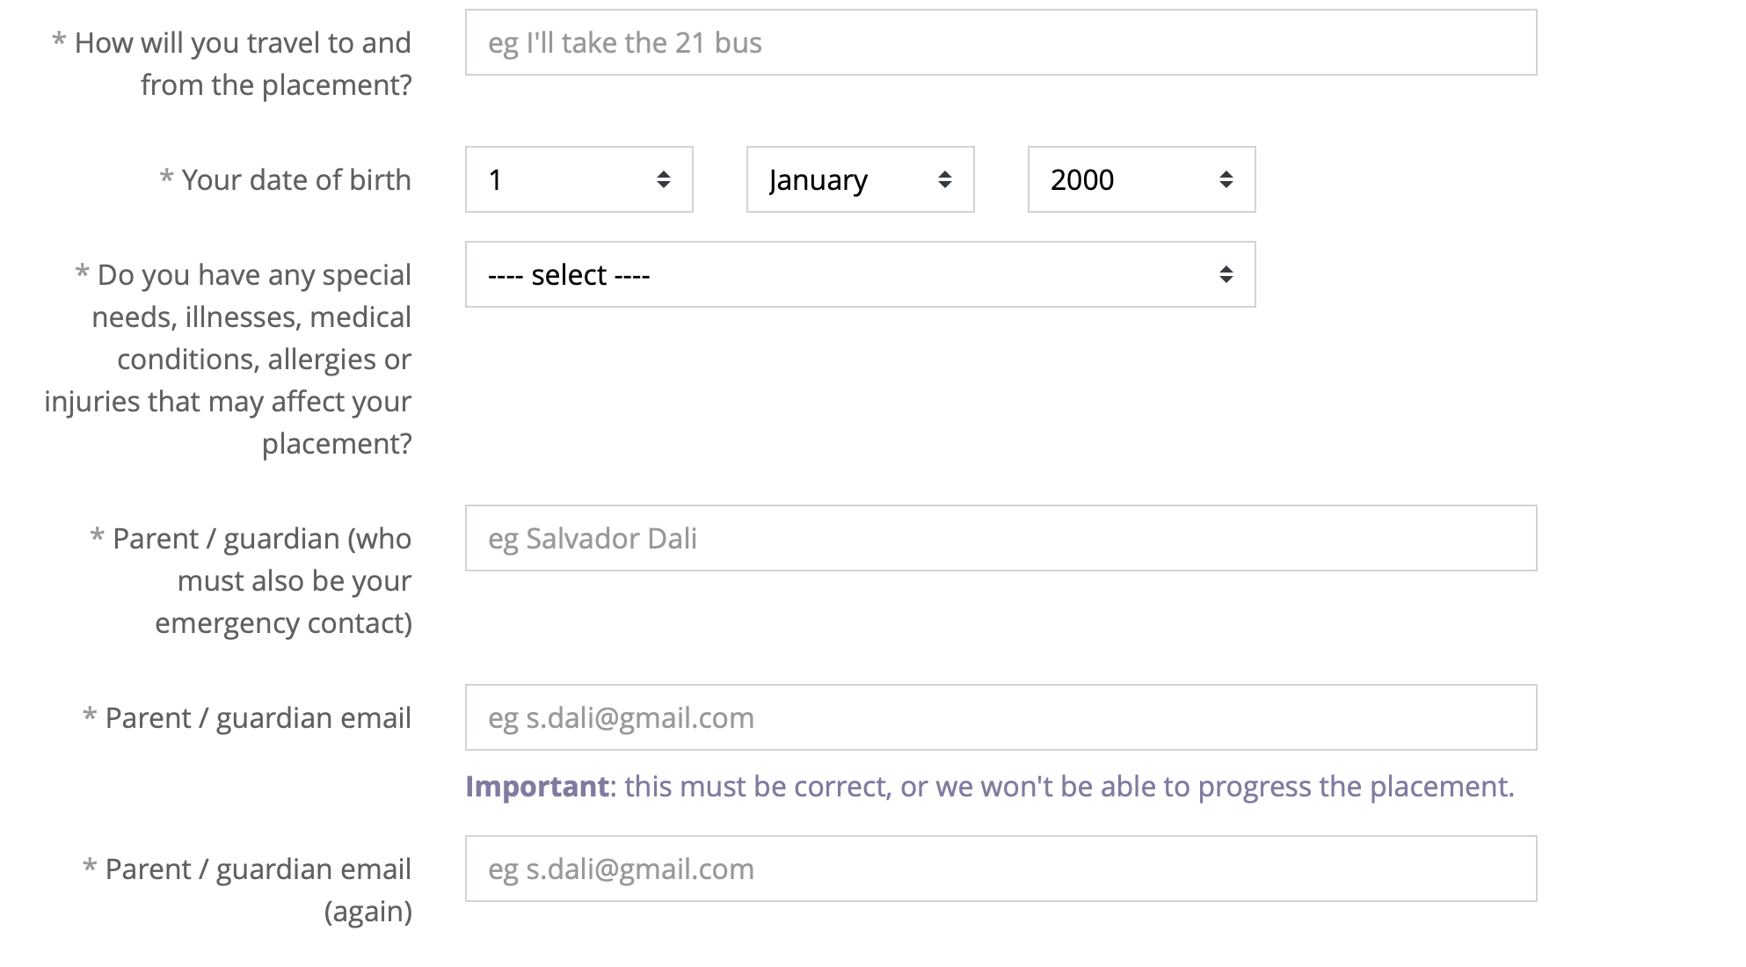

Slide 15
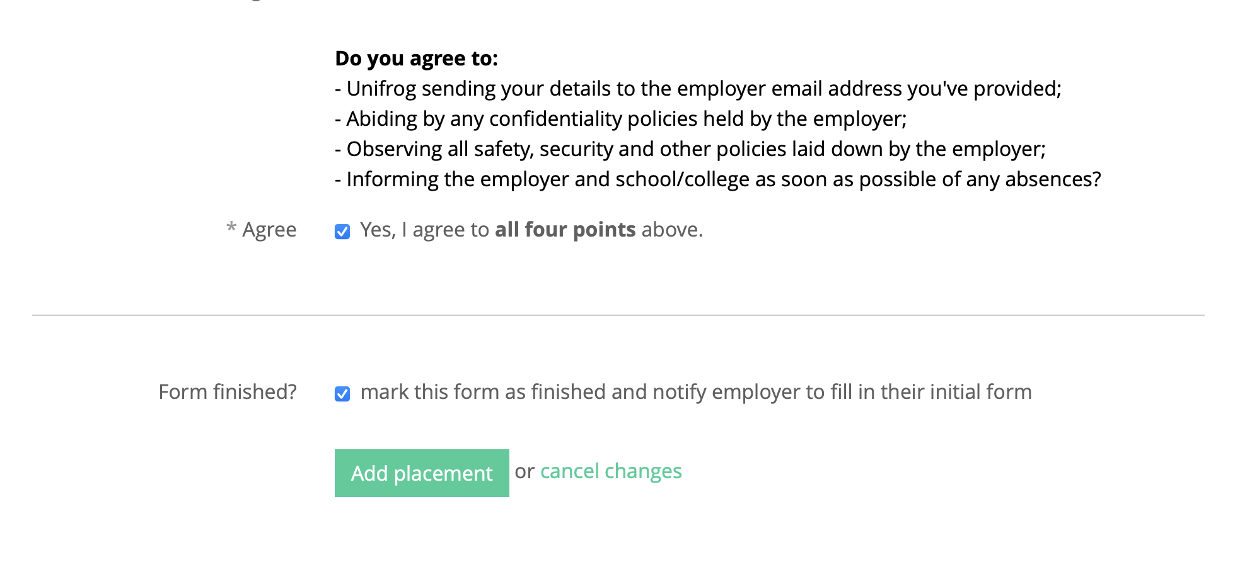

Slide 16
What happens next?
Unifrog contacts the employer and asks them to complete the intial employer form and upload all relevant documentation.
Once this is complete, Unifrog contacts you to ask you to complete the parent permission.
Unifrog then contacts school for us to review all documentation and approve the placement.

Slide 17

Any questions?

